Slide 1
Sales Dataset Analysis
Advanced excel project
INDUJA R
DA & DS
16-12-2024

Slide 2
Agenda
Project Objectives
Data Description & Presentation
Key metrics calculation
Pivot Tables and Pivot Charts
Dashboard Overview
What-If Analysis and Goal Seek
Macros and Automation
Insights and Recommendations
Conclusion

Slide 3
Project Objectives
OBJECTIVES
GOALS:
Identify Sales Trends
Understand Customer Behavior
Boosts profitability
Spot marketing
Enhance Customer Experience

Slide 4

Data Description & Presentation
PROCESS OF CLEANING
Removing duplicate rows and blank entries
Date formatting
Bold headers and freeze top row
Used Power Query

Slide 5
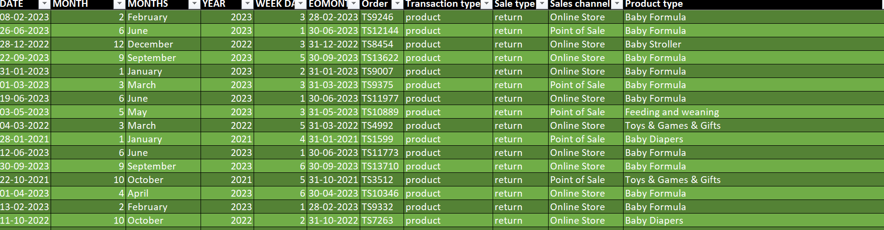
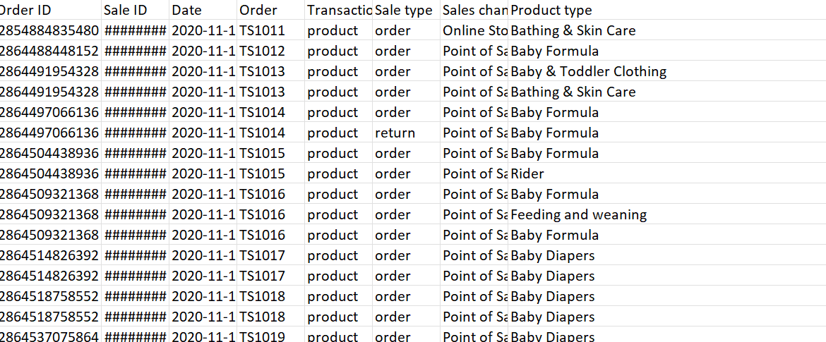
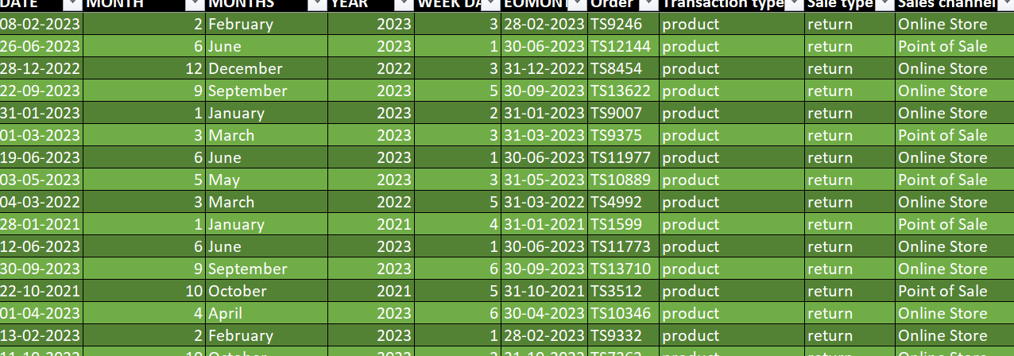
RAW DATA
CLEANED DATA

Slide 6
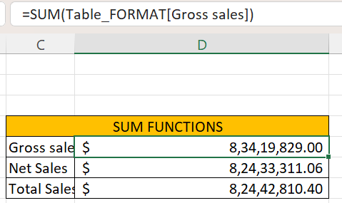
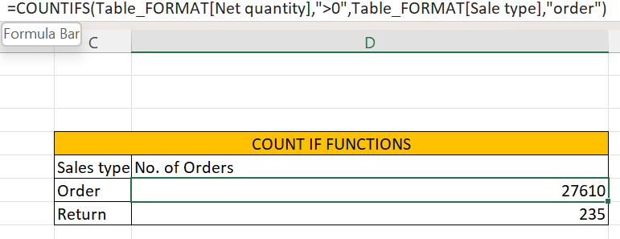
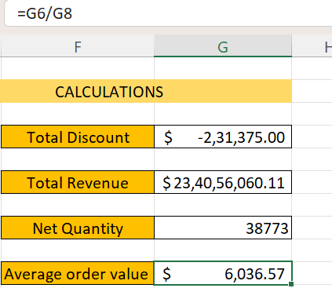
Key metrics calculation
CALCULATIONS
Total sales (Gross, Net, Adjusted)
Average sales per order
Count of orders.

Slide 7
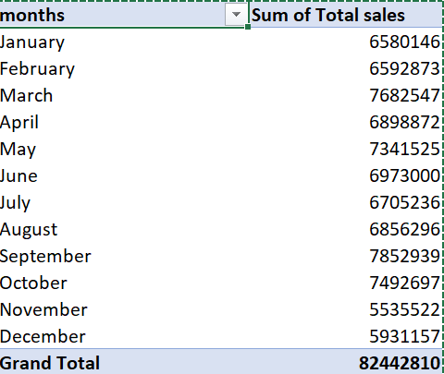
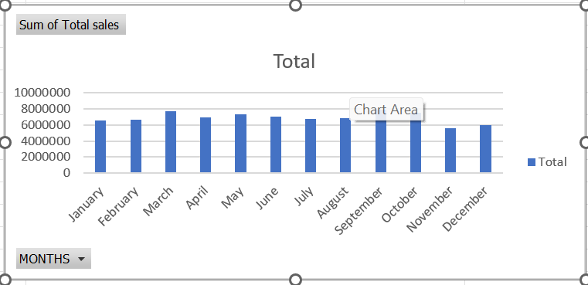
Pivot Tables and Pivot Charts
PIVOT TABLES
Summarize Large Dataset
Interactive Data Analysis
Integration with Pivot charts
PIVOT CHARTS
Easy comparison and Analysis
Customizable Layouts
Simplifies Complex Data

Slide 8
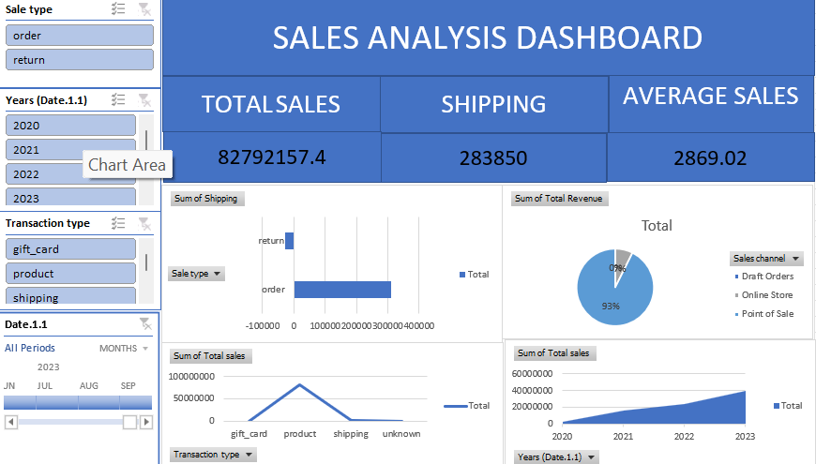
Dashboard Overview

Slide 9
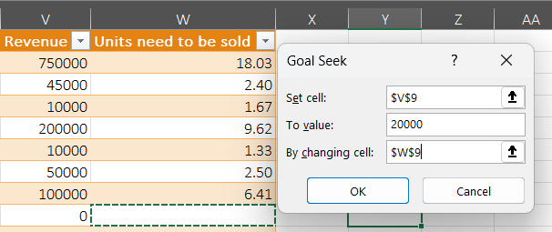
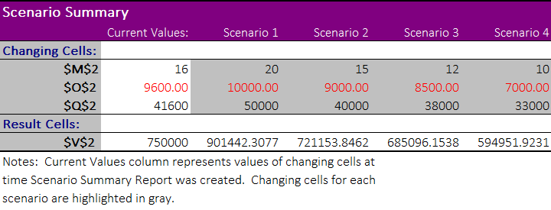
What-If Analysis and Goal Seek
GOAL SEEK
Calculates payments,sales etc.
Quick and accurate solutions.
One variable at a time.
WHAT-IF ANALYSIS
Stimulate outcomes based on changing variables.
Visualize outcomes.
Actionable insights.

Slide 10
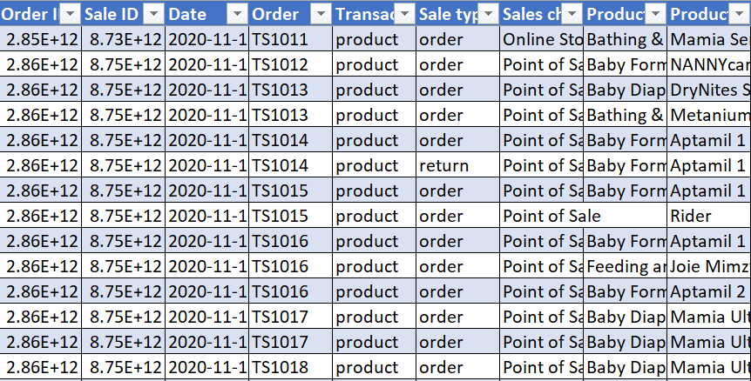
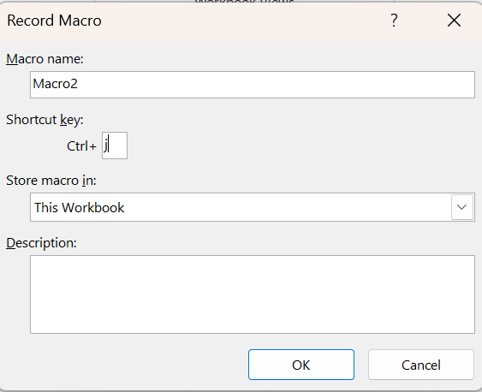
Macros and Automation
USAGE
Automate repetitive tasks.
Reduce Manual errors.
Saves Time.

Slide 11
Insights
Sales channel
Customer Feedback
Pricing Insights
Customer Demographics
Sales Trends

Slide 12
Conclusion
RECOMMENDATIONS
Leverage Emotional Branding.
Quality of a product.
Improve distribution in underserved regions.
Invest in digital marketing to target young parents.

Slide 13
Thank you

